Slide 1
A data-driven method to identify frequency boundaries in multichannel electrophysiology data | Cohen, Journal of Neuroscience Methods, 2021
StepUp Journal Club
15th February 2023

Slide 2

author
Location | Research Area | H-Index
PI Donders Neuroinformatics | Theta and cognitive control & LFP in DBS | 100 Analyzing neural time series data: theory and practice (~1150)

Slide 3
intro
Methods focused paper
Define boundaries of frequency bands in multichannel electrophysiological data (e.g. beta)
Works on individual data

Slide 4
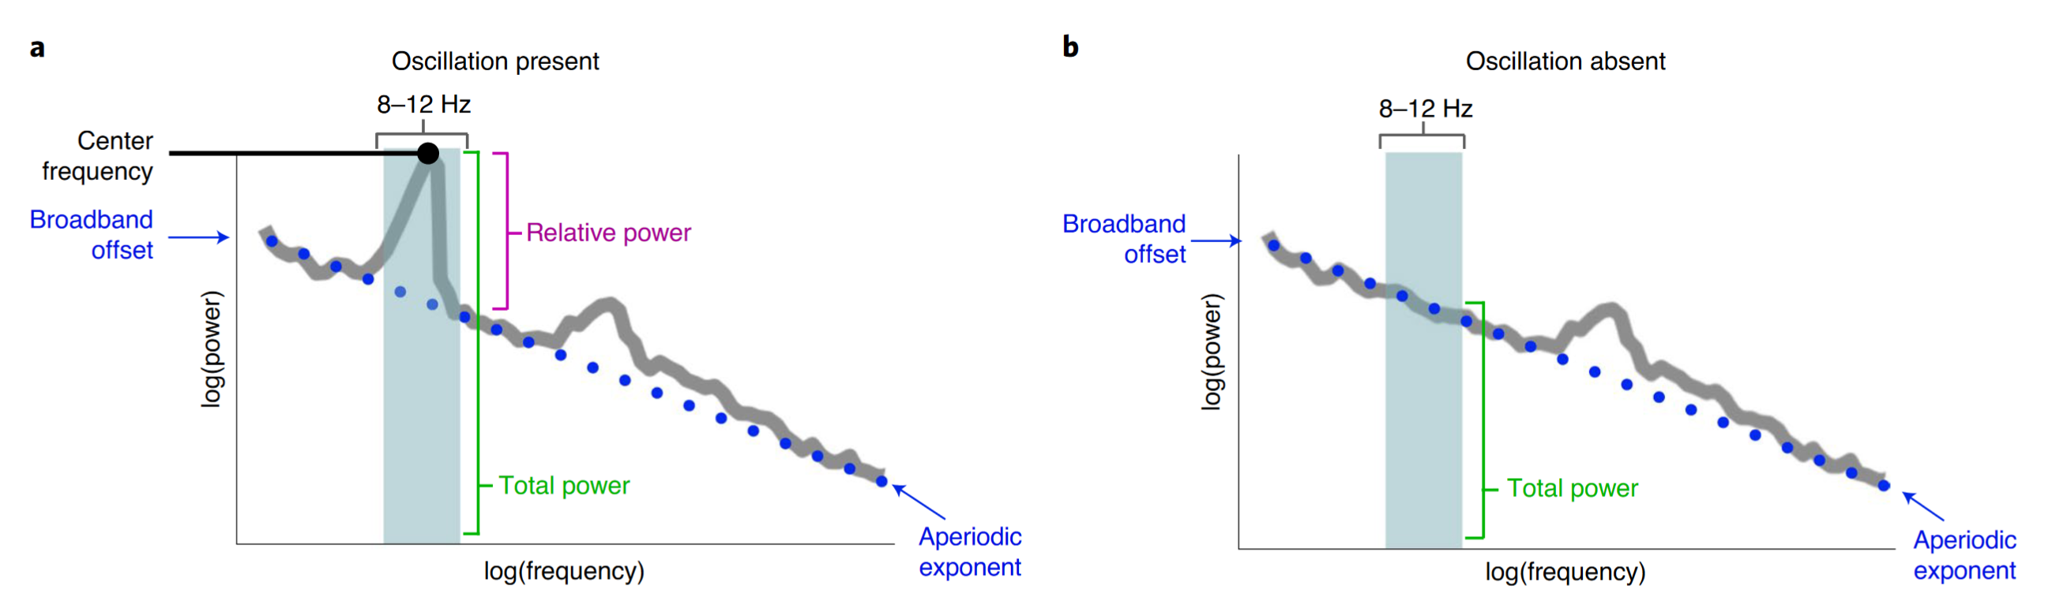
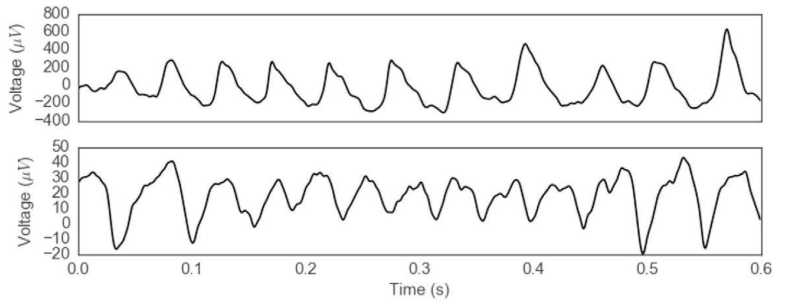
Motivation
“[…] existing methods of empirically detecting frequencies rely on the peaks, typically from individual channels […]”
https://bycycle-tools.github.io/bycycle/index.html
Cole ea., J.Neuroscience, 2017; Donoghue ea., Nature Neuroscience, 2020
Notes:
Example voltage traces from 2 patients corresponding to the sawtooth waveforms in quadrants I and III. These waveform shapes are consistent with the dark gray, but not the light gray, sawtooth shapes in
A: Example neural power spectrum with a strong alpha peak in the canonical frequency range (8–12 Hz, blue-shaded region) and secondary beta peak (not marked). b, Same as a, but with the alpha peak removed.

Slide 5
motivation
“[…] these arbitrary (and nearly always integer-based) cut-offs probably do fairly little damage to the final conclusions of each individual publication […]”
Notes:
As the two spectral bands have different anatomical origins (and thus at least slightly different projections onto the electrodes), their corresponding source-separation eigenvectors will decouple the spectral features better than a slope-based or single-channel-based algorithm

Slide 6
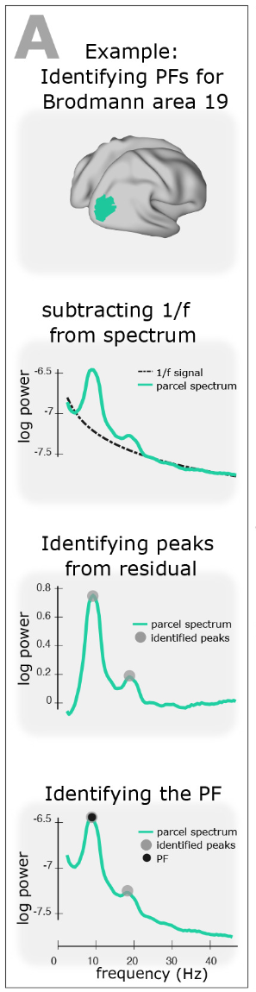
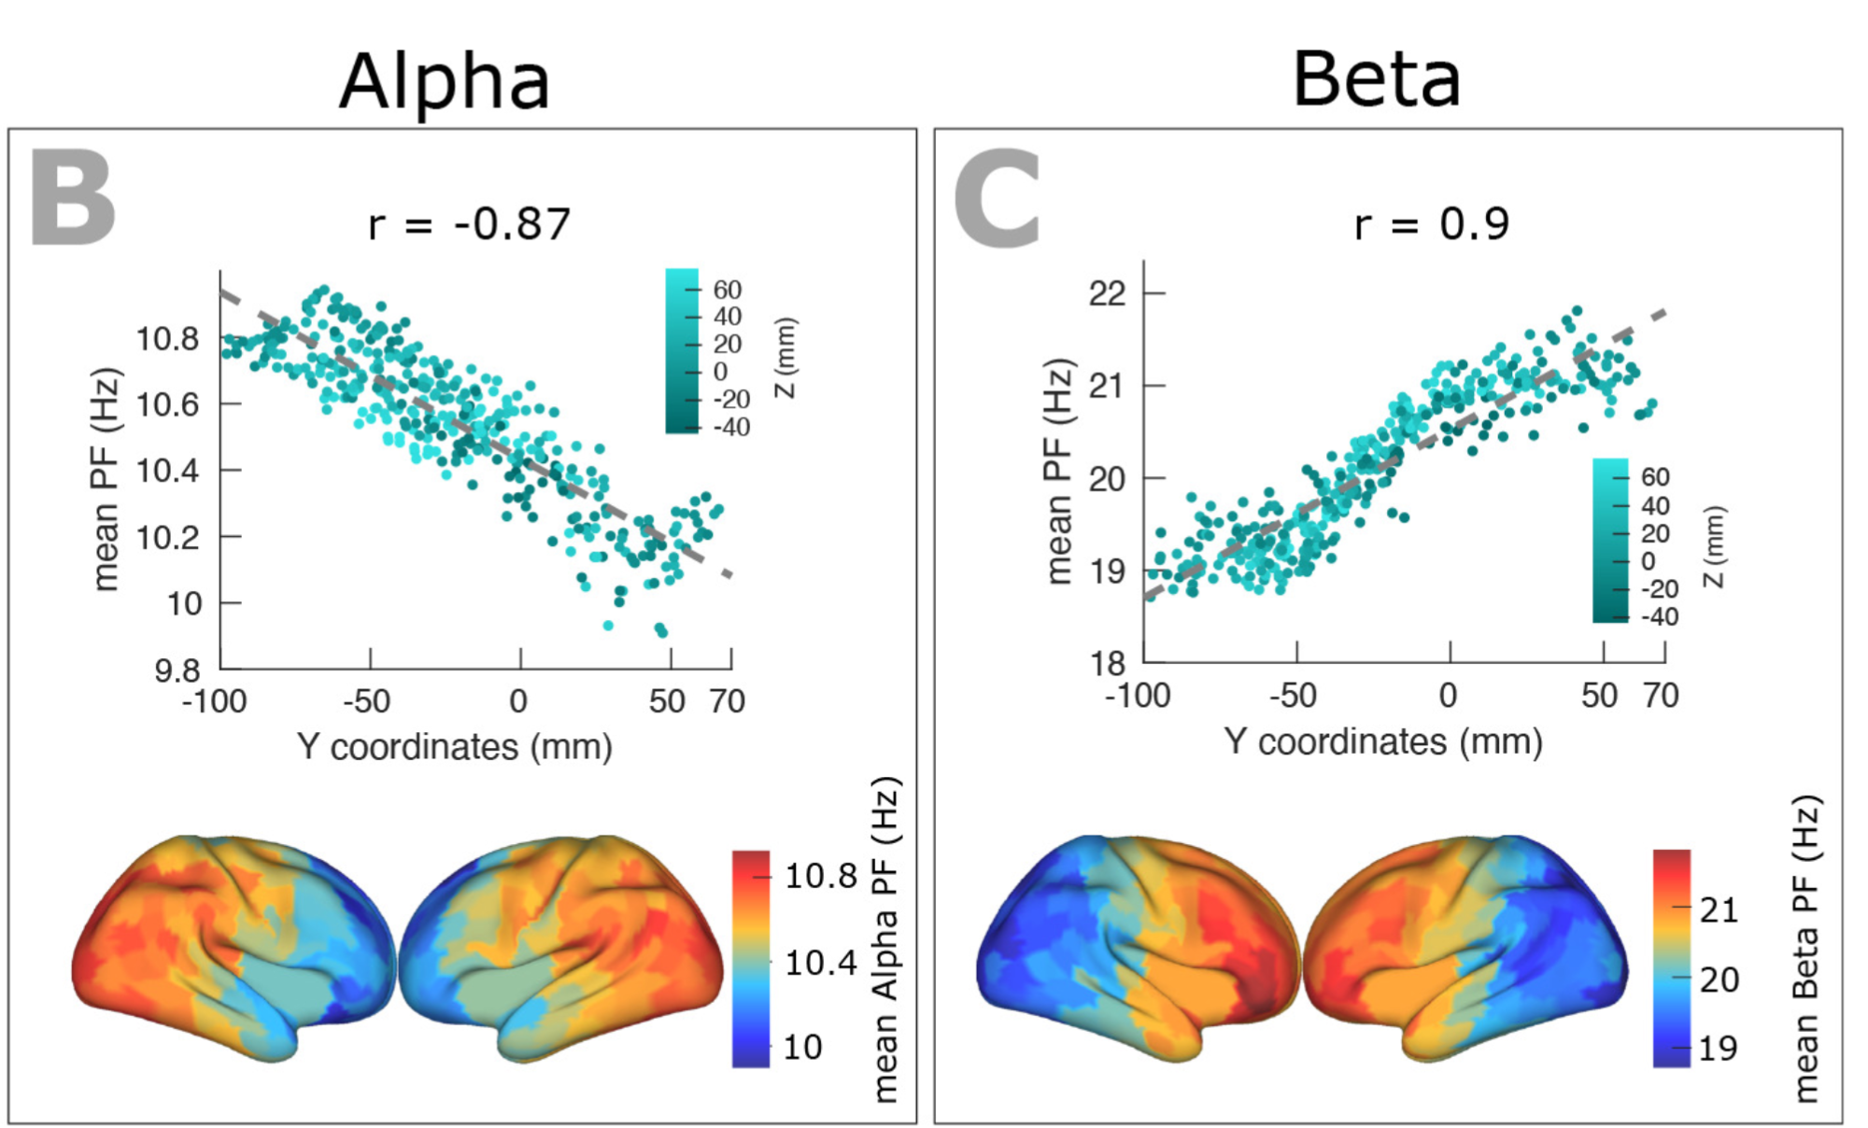
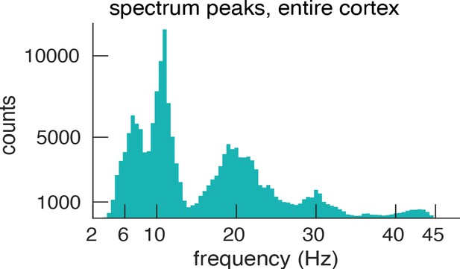
Frequency bands
Mahjoory ea., eLife, 2020
Notes:
Resting state MEG n=187
A: Estimating the power spectrum for each cortical region, and identifying peak frequencies after fitting and subtracting the arrhythmic 1/f component.
B & C: Dependency between the trimmed mean of band-specific PF (187 participants, 384 ROIs) and the ROI’s location along the y-axis (posterior to anterior) for theta (r = 0.4, p<0.001), alpha (r = 0.87, p<0.001), and beta (r = 0.9, p<0.001) bands, respectively. Points are colored according to their Z coordinates.

Slide 7
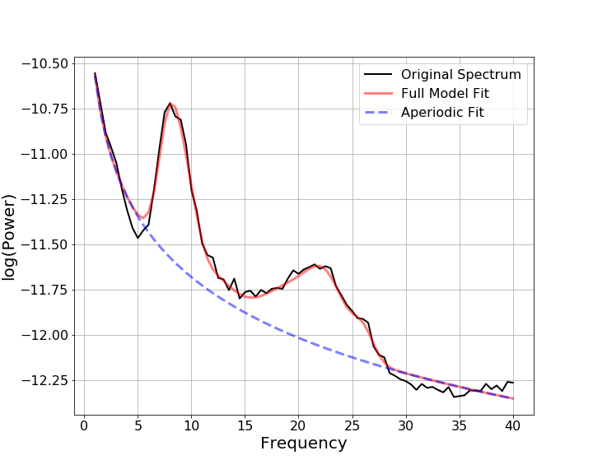
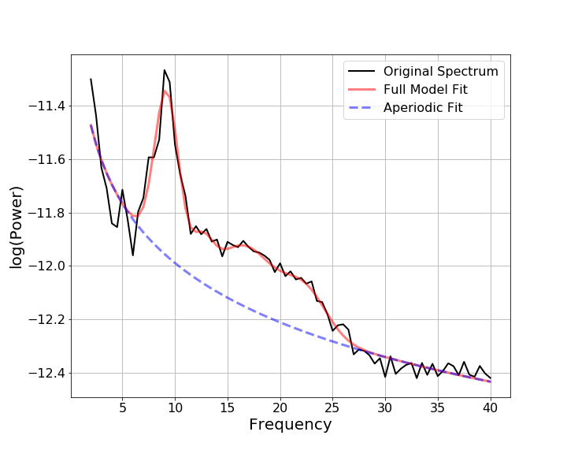
Goal
PD 5 -off
PD 13 -off
Beta band?
Beta band?
UC San Diego Resting State EEG Data from Patients with Parkinson's Disease, OpenNeuro, 2020 (v. 1.0.3)

Slide 8
Get bounds
Assumptions
“Frequency bands” have similar spatiotemporal characteristics
Boundaries between bands can be defined as changes in those similarities
Signal with narrowband activity is expected

Slide 9
Method
| getBounds
Create a channel covariance matrix using broadband data. (R)
In desired frequency range (e.g. 1-40 Hz) create channel covariance (S) per frequency bin
Compute generalized eigendecomposition (GED) on R&S -> spatial filter, maximally separates S from R
Compute pairwise squared correlations across eigenvectors from all frequencies → matrix of eigenvector similarities.
Apply cluster analysis to this matrix to identify “blocks” on the diagonal that have high similarities
MatLab code available
Notes:
Loop over a range of frequencies (e.g., 2-100 Hz). At each frequency, create a channel covariance matrix using narrowband filtered data. This matrix is called ​S for signal. Compute the generalized eigendecomposition on ​S and ​R​, which identifies a spatial filter (a set of weights for all channels) that maximally separates ​S from ​R​, while ignoring any features that are common between the two matrices. The eigenvector of maximal separation is stored (Figure 1a).

Slide 10
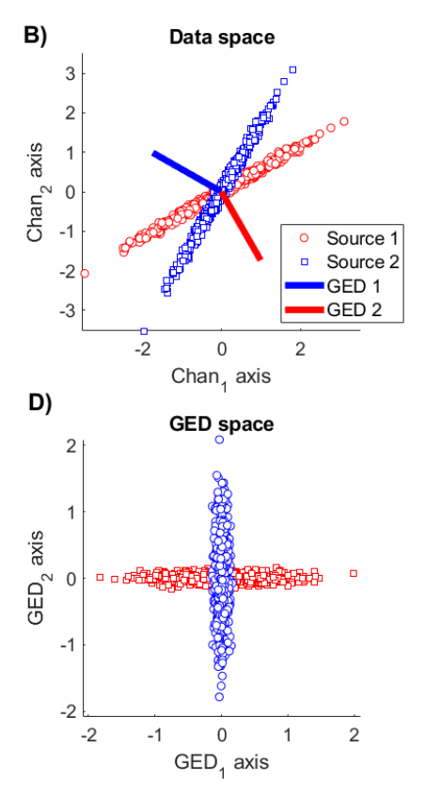
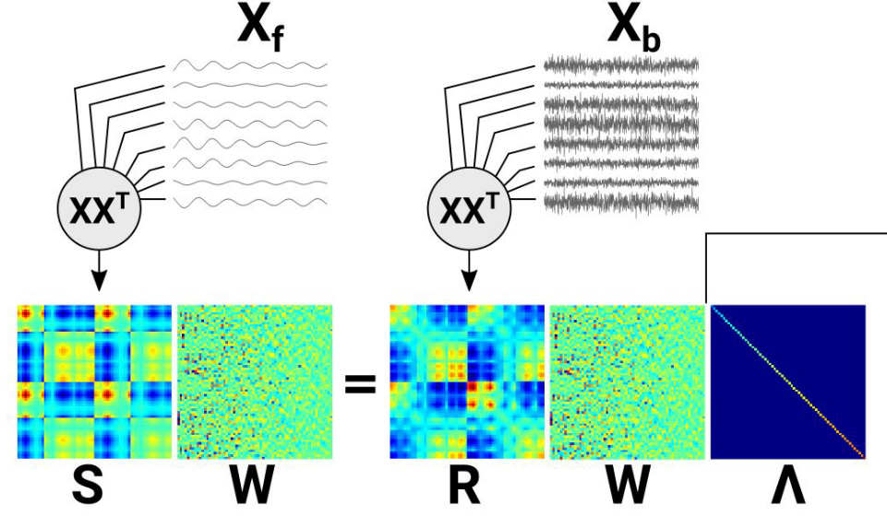
Pipeline 1
GED (R,S)
Notes:
Covariance matrices are used because they encode all pairwise linear relationships across the electrodes, thus allowing the method to leverage volume conduction and spatial autocorrelation to identify spatial patterns in the data, as opposed to the reduced signal-to-noise quality of a single electrode.
Thus, the column of with the largest associated eigenvalue is the spatial filter that maximizes the multivariate energy ratio between the narrowband and the broadband activity

Slide 11
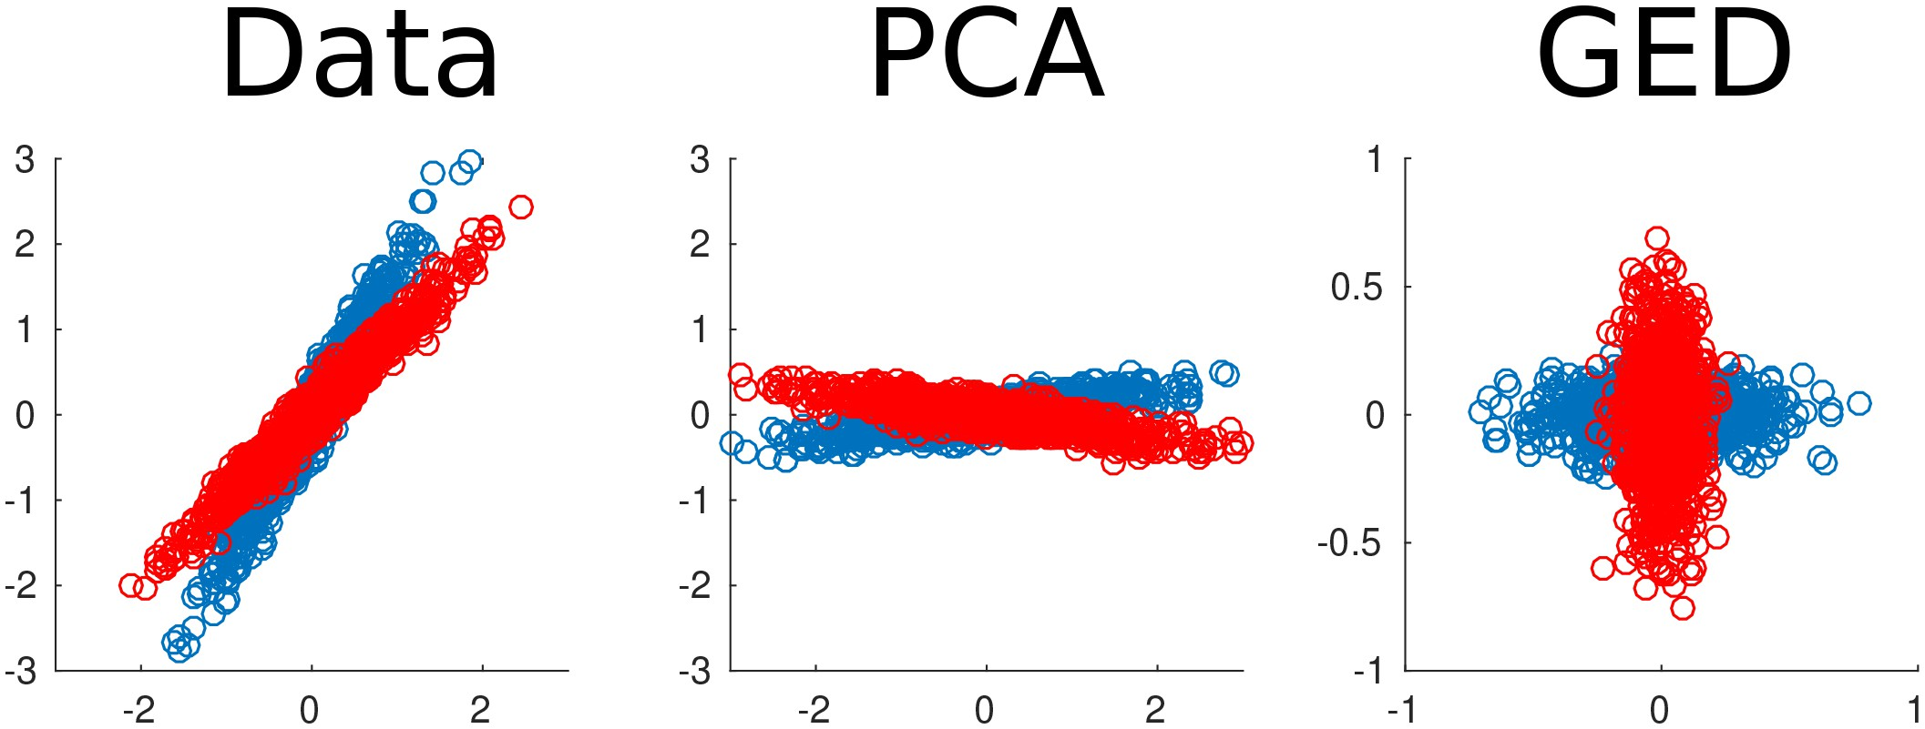
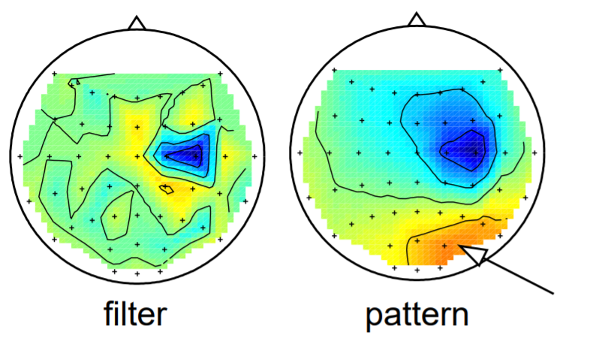
GED
Cohen, eLife, 2017; Blankertz, eLife, 2007
Notes:
the distribution of samples after the filtering is shown. Note that both classes are uncorrelated at the same time; the horizontal (vertical) axis gives the largest variance in the red (blue) class and the smallest in the blue (red) class, respectively.

Slide 12
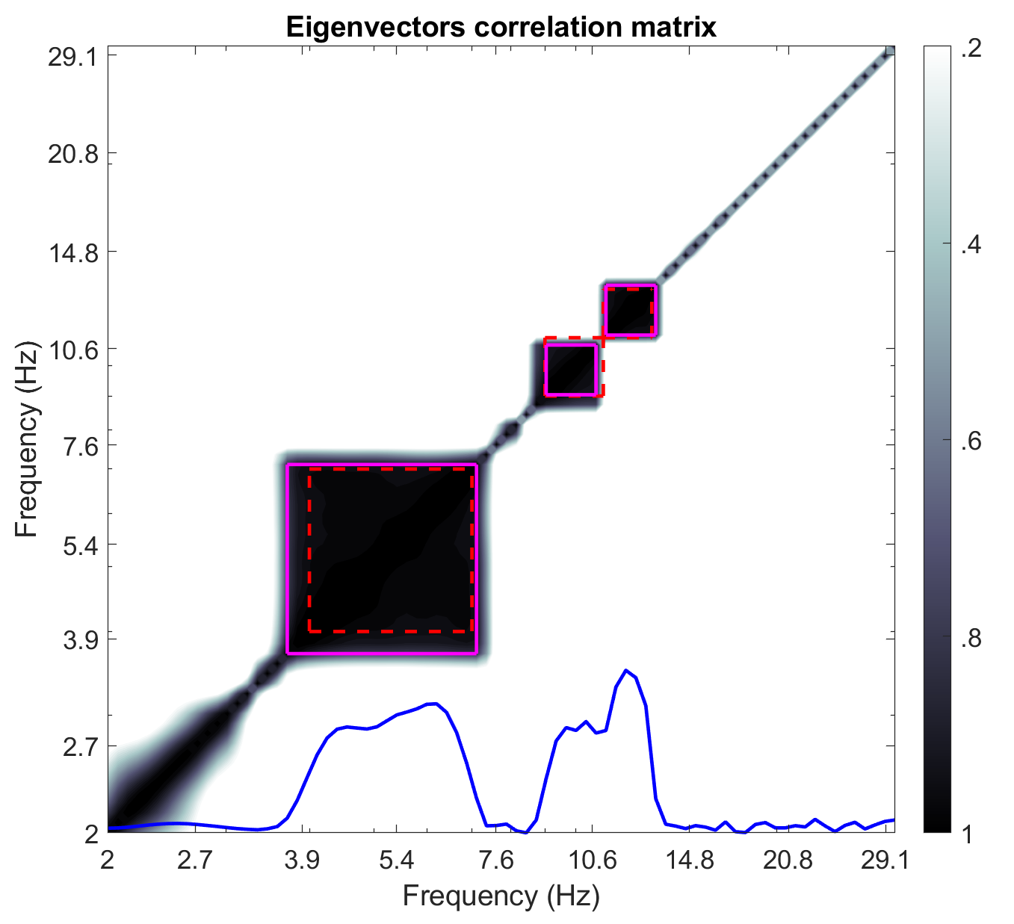
Pipeline 2
Eigenvector correlation matrices
Using top eigenvector from each frequency in [S] -> best separator
Clustering into frequency bins
Dbscan (density-based spatial clustering)
… a lot of tuning possibilities

Slide 13
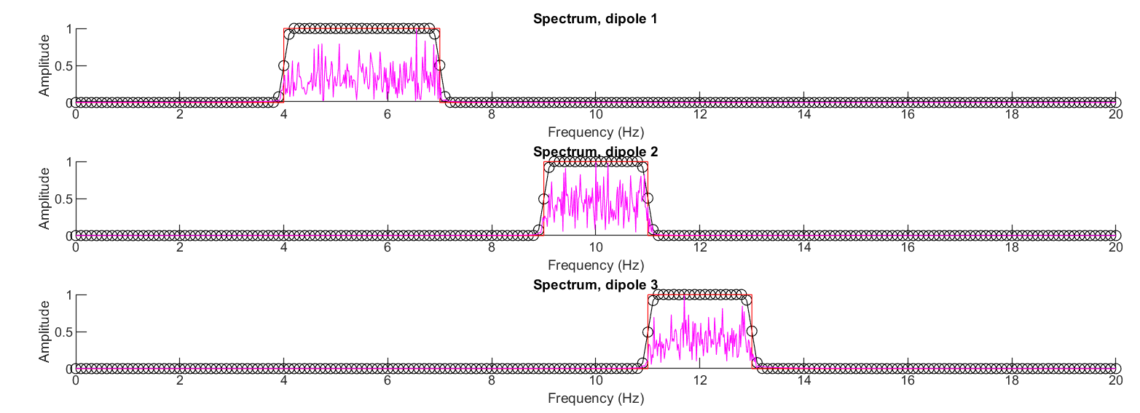
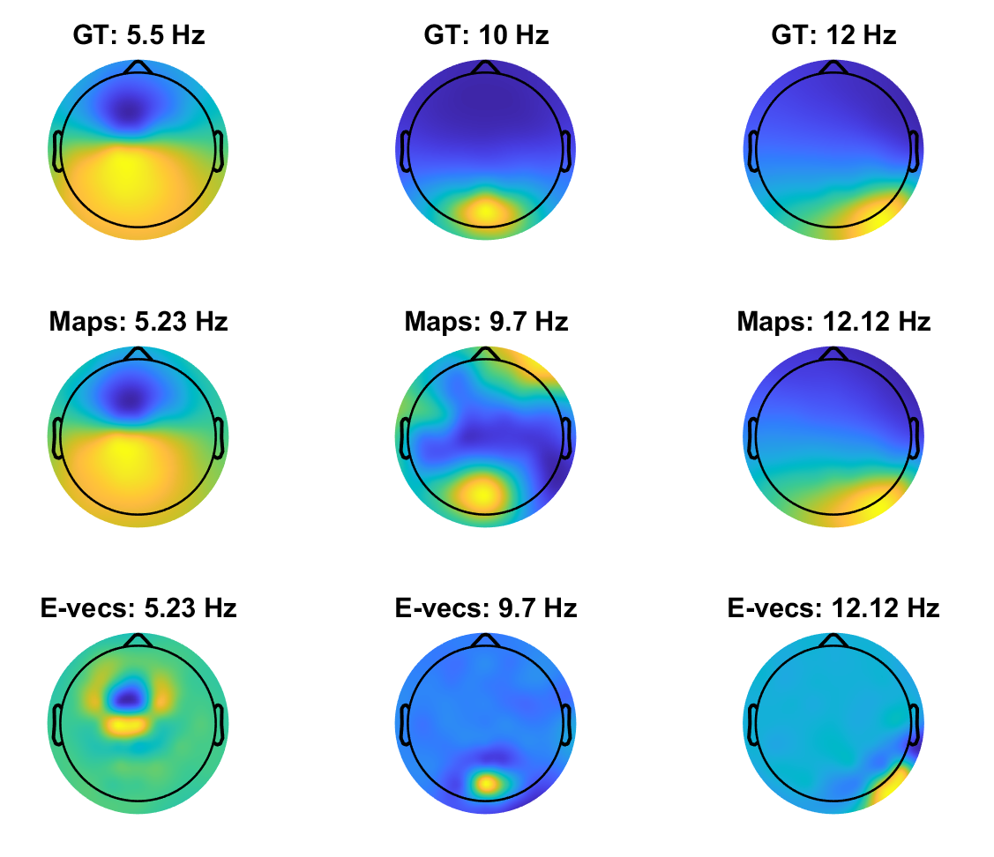
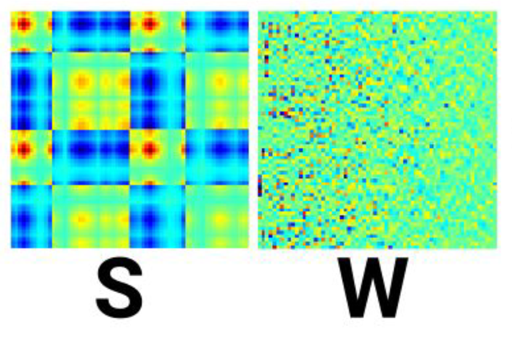
Interpretation
Notes:
Topographical maps show the PCA-averaged forward model for each cluster

Slide 14
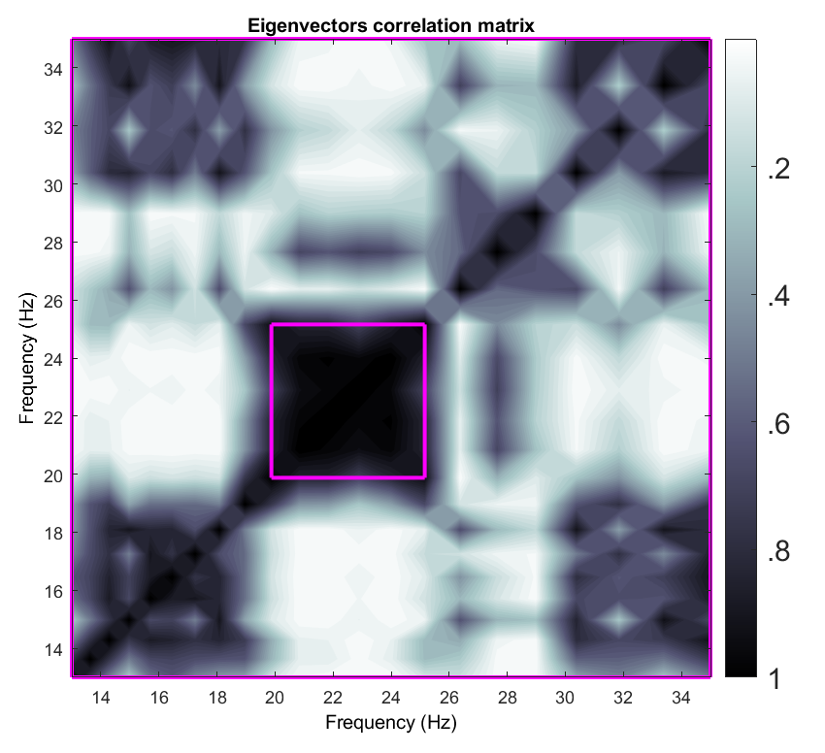
Does it work?
PD 5 -off
Beta band?

Slide 15
Does it work?
Correlation of Eigenvectors at each Frequency
Maximal separates what exactly?
Narrowband from Broadband data!
In what regard?
Spatial characteristics
→ When two spectral bands have different anatomical origins , source separation will decouple the spectral features

Slide 16
Does it work?
| sometimes yes
PD 5 -off
Beta band?
GED

Slide 17
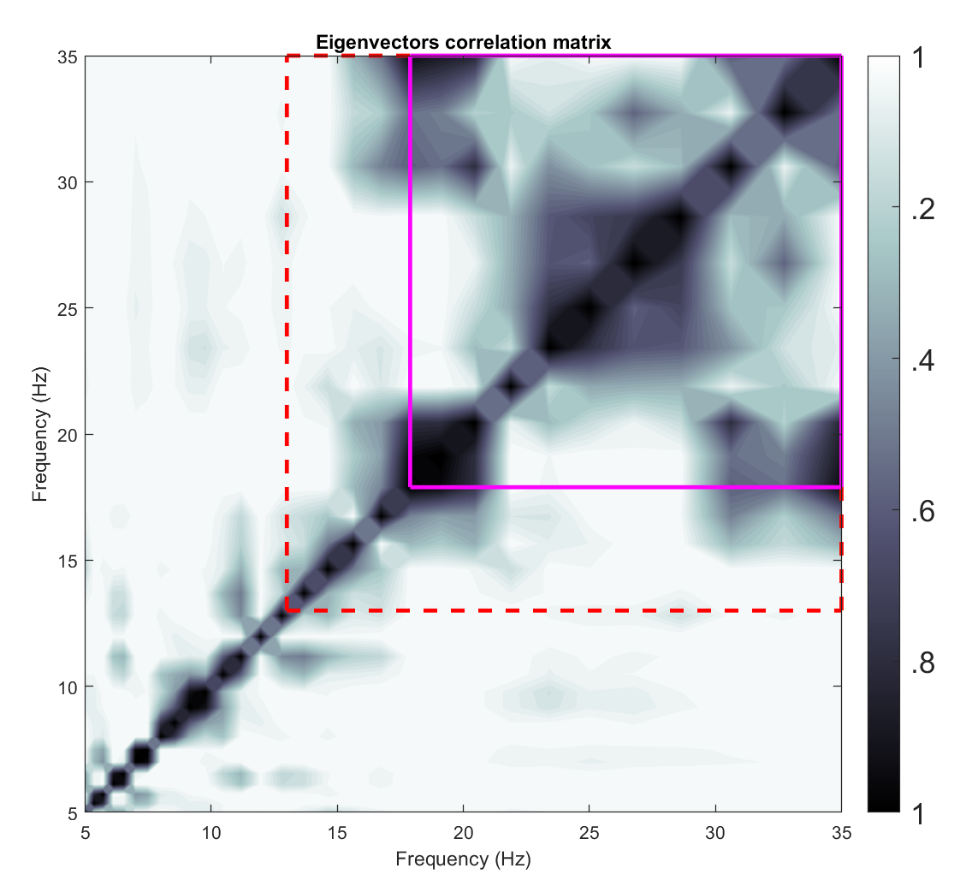
Does it work?
| sometimes no
PD 13 -off
Beta band?
UC San Diego Resting State EEG Data from Patients with Parkinson's Disease, OpenNeuro, 2020 (v. 1.0.3)

Slide 18
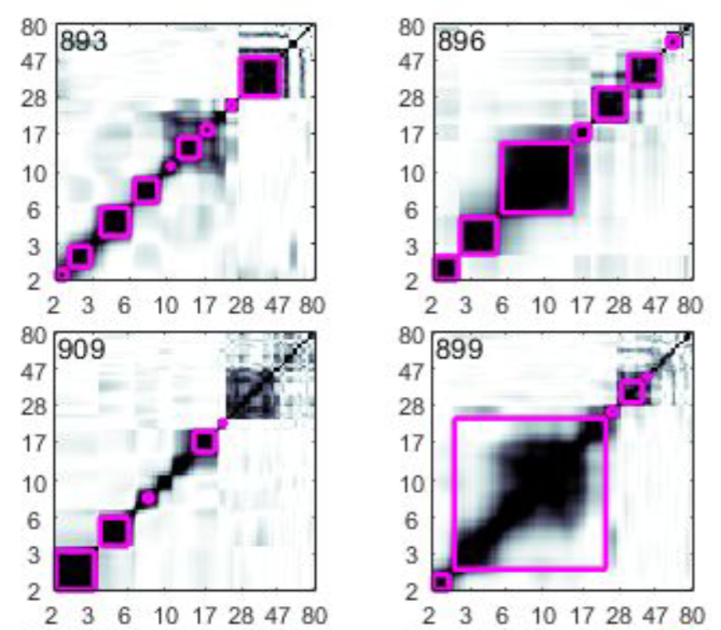
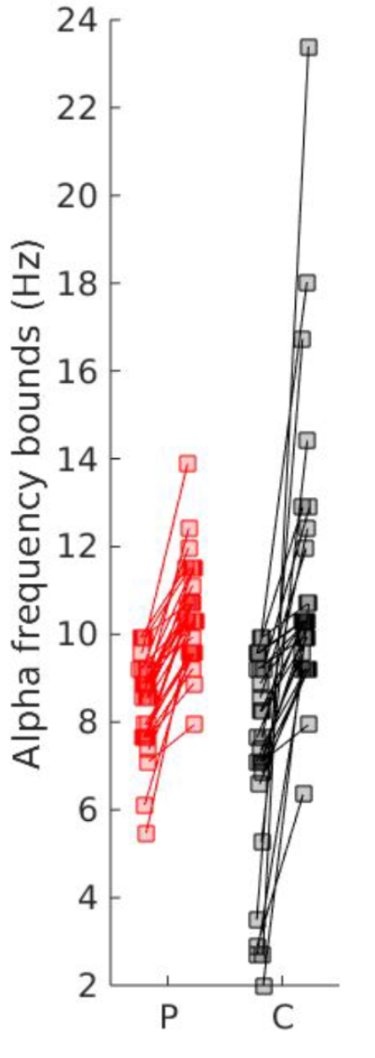
More PD data

Slide 19
Take home
GED can be used for the detection of individual frequency boundaries
Depending on spatial characteristics, the results can vary a lot
Clustering of eigenvector correlations is unstable

Slide 20
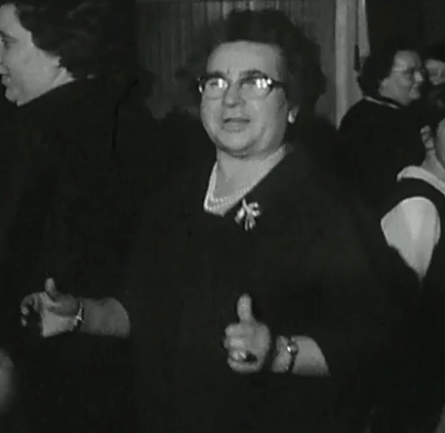
Thanks for listening carefully

Slide 21
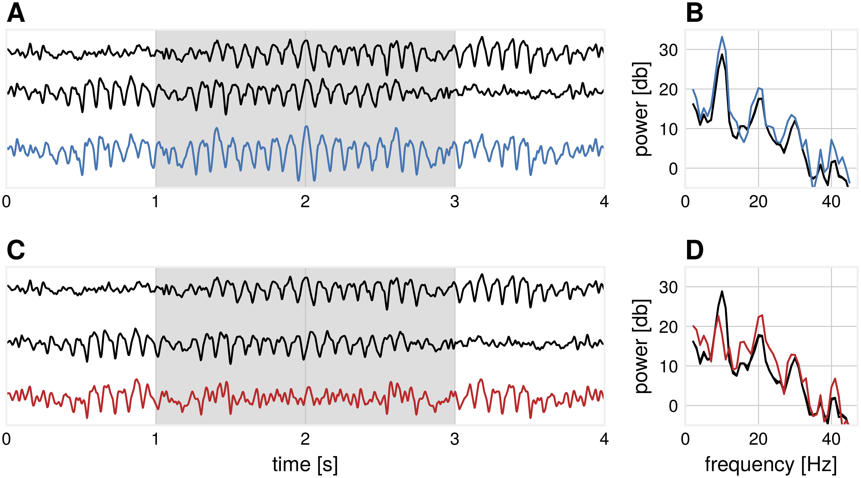
Non sinusoidal waveforms
Schaworonkow & Nikulin, PLOS Comp. Bio., 2019
Notes:
Fig 5. Illustration: The emergence of β-events from α-dominated sources.
(A) Two basis functions (black) mix with a temporal delay (σ = 15 ms) such that the α-power is enhanced in the compound signal (blue) during the segment marked in gray. (B) The corresponding power spectrum of the segment marked in gray for subplot (A) for basis functions (black) and compound signal, where both α- and β-spectral peaks are enhanced (blue). (C) Two basis functions (black) mix with a temporal delay (σ = 43 ms) such that the α-power is diminished in the compound signal (red) during the segment marked in gray. (D) The corresponding power spectrum of the segment marked in gray for subplot (C) for basis functions (black) and compound signal, where the α-peak is largely diminished and β-peak is enhanced (red).

